Slide 1


Adidas Sales Analysis
By:
Hrithik Ahuja
Group 4

Slide 2



Data Set Information
Invoice Date: Date of transaction.
Region: Geographic region of sales (Midwest, Northeast, South, etc.).
Product: Product categories (e.g., Men’s Street Footwear).
Price per Unit: Selling price per product unit.
Units Sold: Number of units sold.
Total Sales: Revenue generated from the sales of units.
Operating Profit: Profit after deducting expenses.
Operating Margin: Profitability as a percentage of sales.
Sales Method: Sales channel (e.g., In-store or Online).

Slide 3

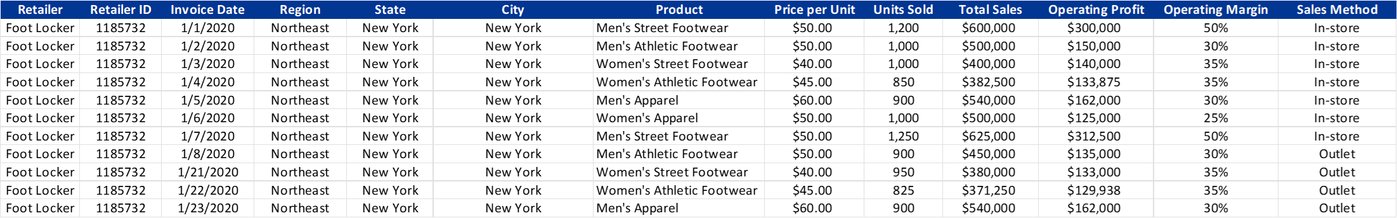

Sample Data

Slide 4




Research Questions
Question 1
Question 2
Question 3
How does price sensitivity vary among different product categories, and what impact does this have on operating profit and volume?
Cost of Goods Sold (COGS) and Profit Margins: "What Are the True Costs of Selling Adidas Products?"
How do product lifecycles (introduction, growth, maturity, and decline phases) affect Adidas’s sales strategies, and what are the early indicators of a product entering the decline phase?
Question 4
Question 5
How do sales vary over time for different product categories?
What factors contribute to higher total sales for retailers?
Question 6
Which sales methods are most effective in driving high sales volumes across different regions?

Slide 5
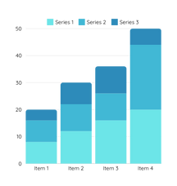
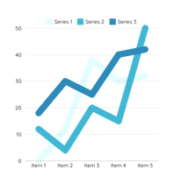
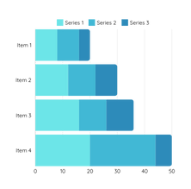

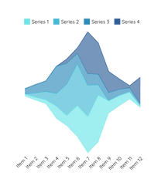
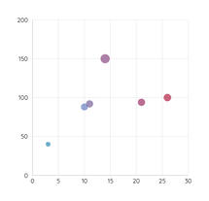
Methodologies
Stacked Bar Chart
Line Chart
Heat Map
Horizontal Bar chart
Map
Scatter Plot

Slide 6
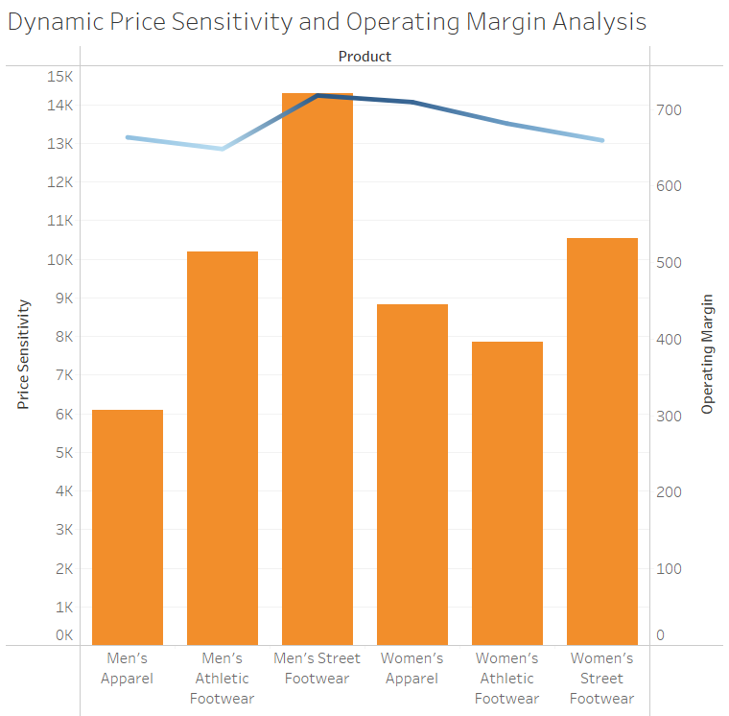

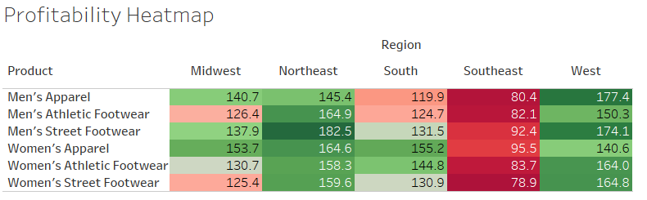
Dynamic Price Sensitivity and Operating Margin Analysis
High price sensitivity often correlates with higher sales volume, but profitability depends on cost efficiency and pricing strategies.
Products like Men's Street Footwear and Women's Street Footwear balance volume and profit effectively, while Athletic Footwear struggles in both aspects.
Regional differences play a critical role in profitability. Products with high price sensitivity are more resilient across regions, while those with low sensitivity may require targeted strategies to address regional challenges.

Slide 7
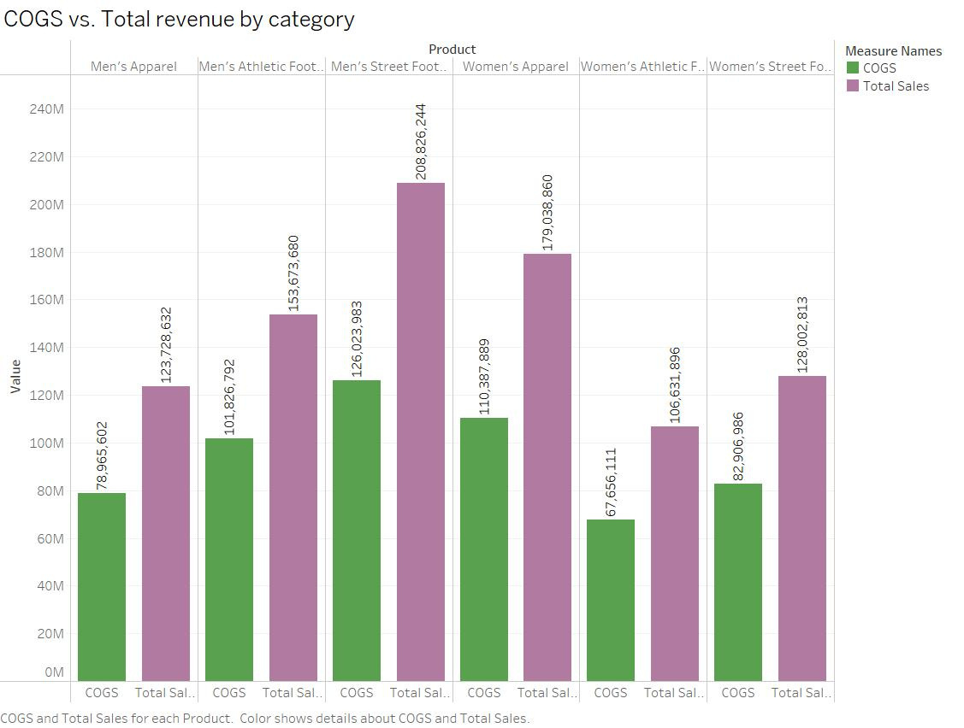
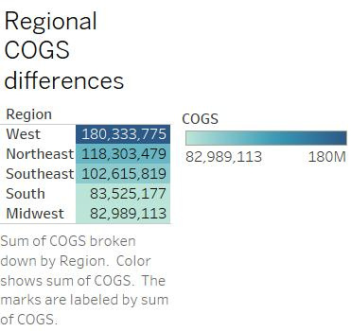
COGS vs Total Revenue by Category
Insights:
Higher revenue categories tend to have a proportional increase in COGS, indicating a consistent cost-to-revenue ratio in this instance Men’s Street Footwear. In Categories like Women’s athletic Footwear with lower ratio, it may highlight operational efficiency or premium pricing strategies.
Regional differences in COGS could be attributed to supply chain costs, local market dynamics, or operational efficiencies. For example, West regions has COGS value at 180 million which might indicated because of higher logistics expenses or import duties.

Slide 8
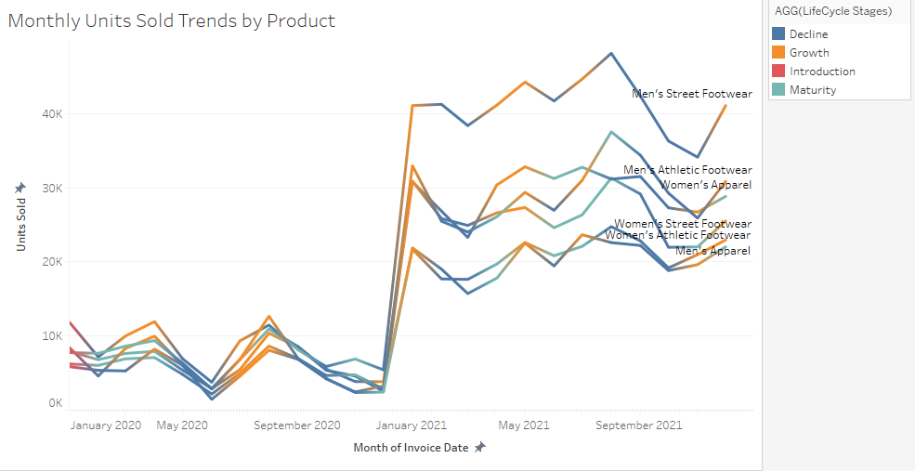

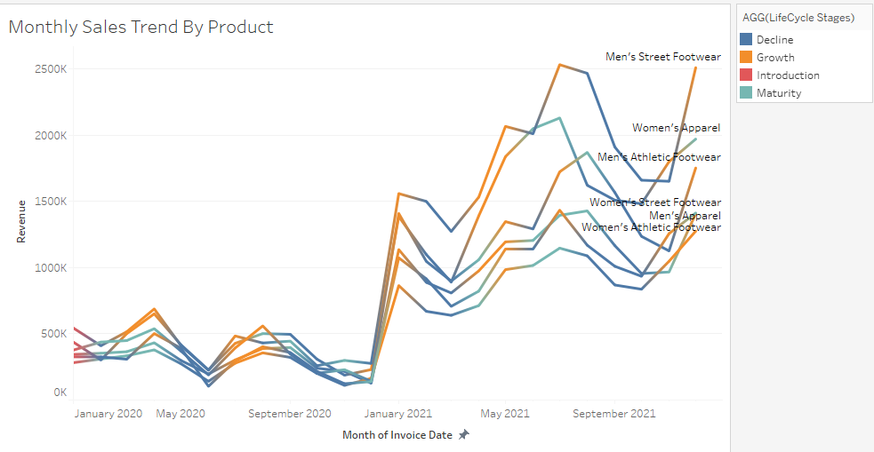
How Do Product Lifecycles Affect Adidas’s Sales Strategies?
01
Introduction Phase
A new product with units sold under 15,000 per month and high marketing spends (e.g., "Men's Street Footwear" during early launch periods) is likely in the introduction phase.
02
Growth Phase
Products like "Men's Athletic Footwear" saw units sold rise from 15,000 (Q2 2020) to 50,000 (Q1 2021), indicating the growth phase.
03
Maturity Phase
"Women's Street Footwear" maintained steady sales of 30,000-35,000 units per quarter in 2021, suggesting a mature product.
04
Decline Phase
"Men's Street Footwear" showed a 50% drop in units sold from Q4 2020 to Q4 2021, alongside shrinking margins (from 50% to 30%).

Slide 9
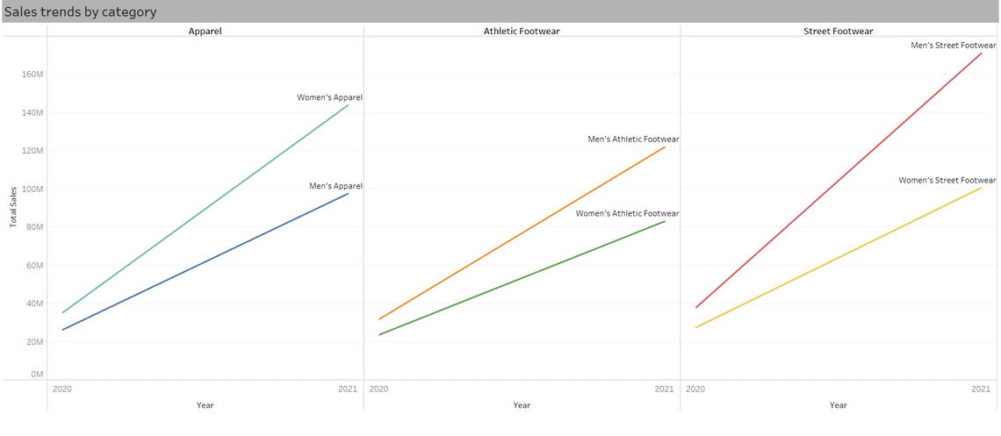
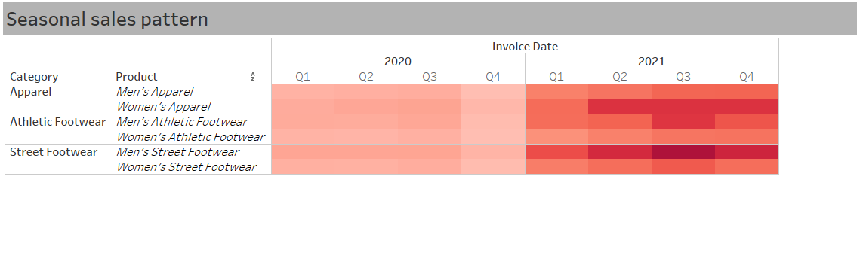
Seasonal Sales Pattern Analysis Over Time
Seasonal patterns are recurring changes in sales or demand based on specific times of the year, such as holidays or seasonal events.
Apparel experiences clear seasonal peaks, particularly during the holiday season, when consumers often shop for better deals from outlets and online.
Athletic Footwear sees a rise in Q1, linked to New Year fitness resolutions. Street Footwear maintains consistent sales year-round, showing less seasonality and stable demand.
Sales for Street Footwear, Apparel, and Athletic Footwear from 2020 to 2021 show varying patterns, reflecting the recovery phase post-pandemic. Street Footwear maintains steady sales, Apparel experiences seasonal peaks, and Athletic Footwear sees significant growth.
These trends highlight how each category responds to demand shifts, seasonal factors, and evolving consumer behavior during the recovery phase.

Slide 10
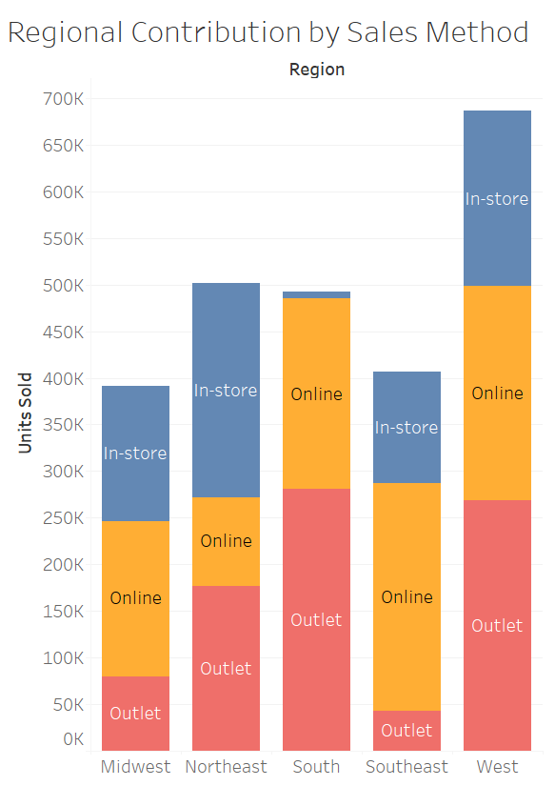
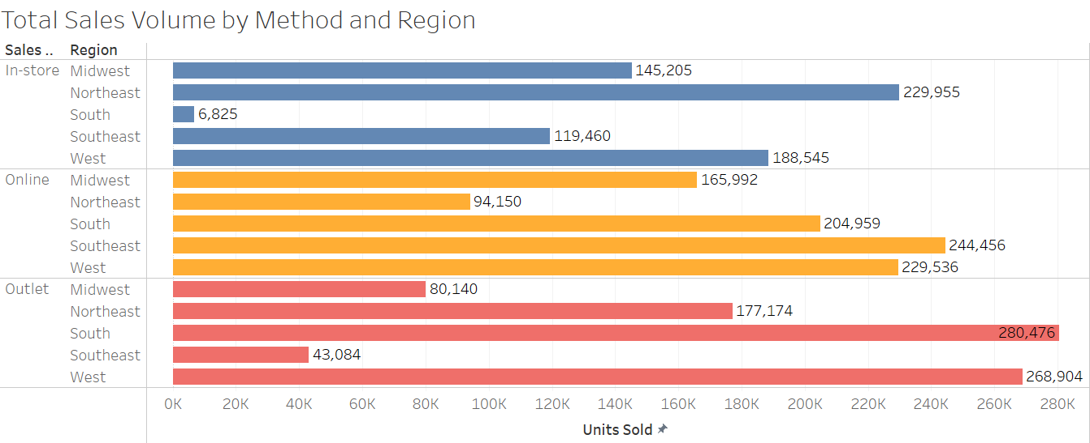
Regional Effectiveness of Sales Methods in Driving High Sales Volumes
West, although not a leader in any, it contributes significantly in all three sales channels. This indicates a strong and diverse consumer market in the West region.
The South contributes very well both online and outlet segments, but very poorly in online segment. The low In-store sales volume in the South could be due to a limited retail store presence or a younger, tech-savvy population favoring other shopping methods. Potential reasons should be analyzed, and targeted strategies implemented to boost In-store sales in this region.
The Midwest and Southeast have lower overall sales volume, presenting opportunities for growth, especially in outlet and In-store channels.

Slide 11
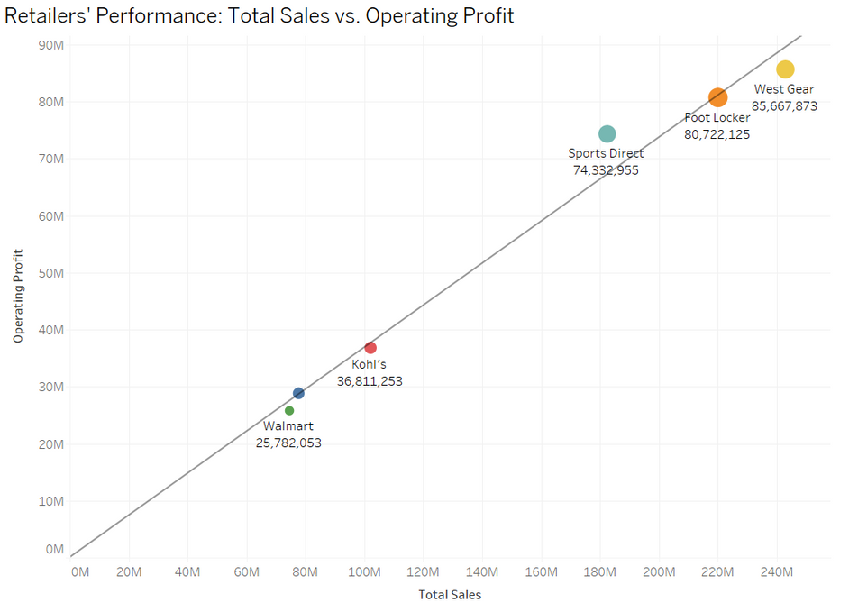
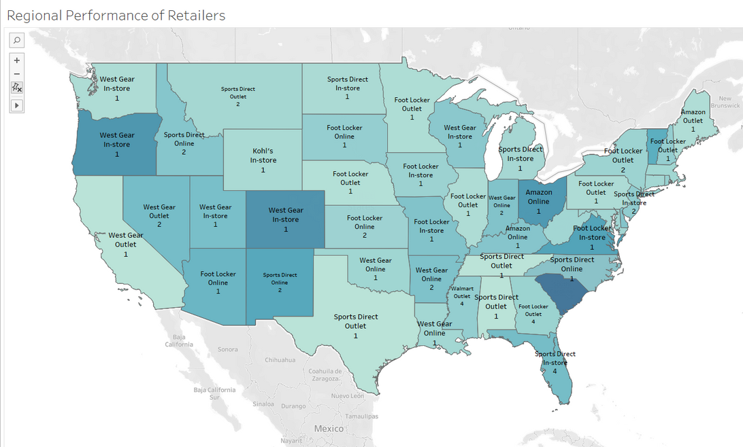
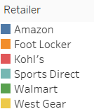
Retailers' Performance: Total Sales vs. Operating Profit
The scatter plot shows the relationship between Total Sales and Operating Profit for retailers. Top performers like West Gear and Foot Locker demonstrate high efficiency and profitability, while others like Walmart and Kohl's face challenges in converting sales to profit.
Retailers with balanced operational strategies and alignment with consumer demand achieve higher profitability, highlighting the importance of cost optimization and effective market strategies.
Regional trends reveal differences in performance across retailers and sales channels, with certain areas favoring specific methods like In-Store or Outlet sales.
The map shows West Gear In-Store as a top performer in the western regions and Foot Locker Outlet as strong in central and eastern states.

Slide 12



Thank you

